Slide 1
House Price Prediction
Prepared By: Dishant Doshi

Slide 2
Problem Statement: -
A US-based housing company named Surprise Housing has decided to enter the Australian market. The company uses data analytics to purchase houses at a price below their actual values and flip them at a higher price. For the same purpose, the company has collected a data set from the sale of houses in Australia. The data is provided in the CSV file below. The company is looking at prospective properties to buy houses to enter the market.
You are required to build a model using Machine Learning in order to predict the actual value of the prospective properties and decide whether to invest in them or not. For this company wants to know:
Which variables are important to predict the price of variable?
How do these variables describe the price of the house?

Slide 3
EDA
EDA is the approach to analysing data sets to summarize their main characteristics.
Many Libraries are available to perform EDA like pandas,seaborn and matplotlib.
Steps in EDA: -
Variable Identification
Univariate Analysis
Bivariate Analysis
Handling Missing Values
Handling Outliers

Slide 4
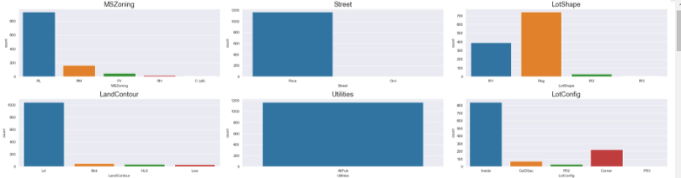
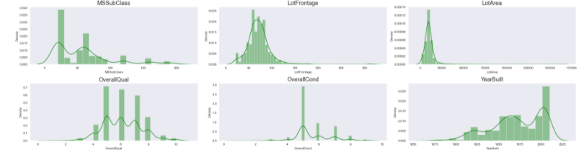
Visualization: - Univariant Analysis

Slide 5
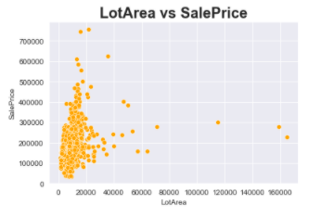
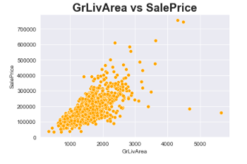
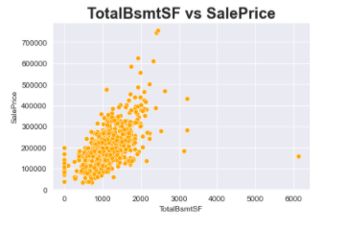
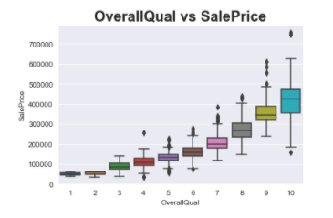
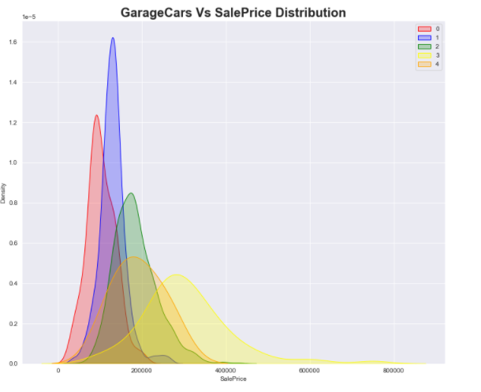
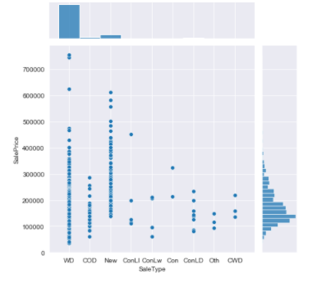
Visualisation: - Bi Variate Analysis

Slide 6
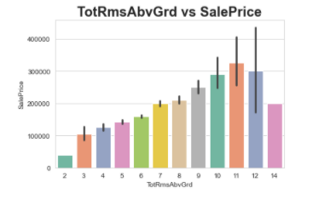
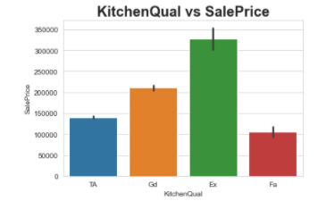
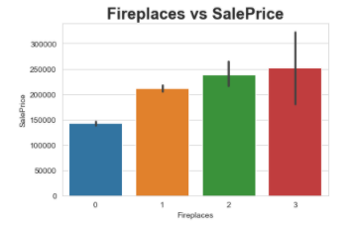
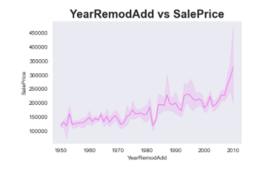
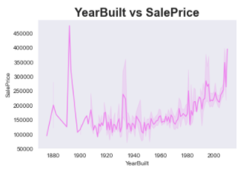
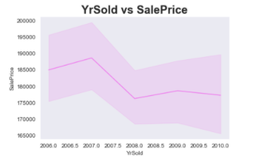

Slide 7
Data Pre-processing: -
Handling Missing Values
Label Encoding: Converting Label into the Numeric Form
Data Cleaning
Removing Outliers(If Required)
Removing Skewness
Feature Selection
Standardization: It is the process of putting different variable into the same scale so that we can compare both score.

Slide 8
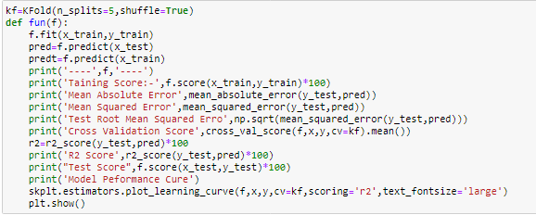
Splitting Data Into Train Test
Here, I create this function for apply on the different different models.
I used Matrices like Mean Absolute Error, Root Mean Squared Error and R2 Scores
I also used KFold Cross validation methods to check overfitting and underfittings
From Skplt I used performance curve for evaluation.

Slide 9
Dashboard Of The Model
From this we can see that some model is Overfitting and Some are Underfitting but
I get the Best result in LGBM Regressor which having less RMSE and CV is good.

Slide 10
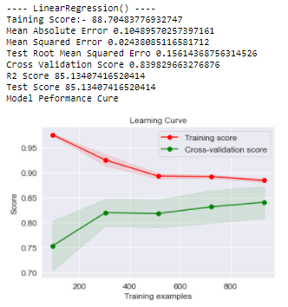
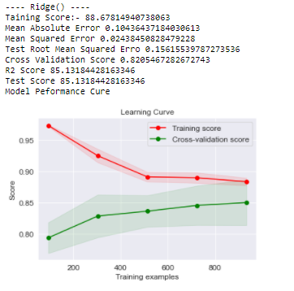
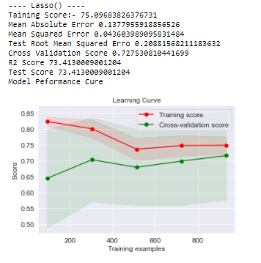
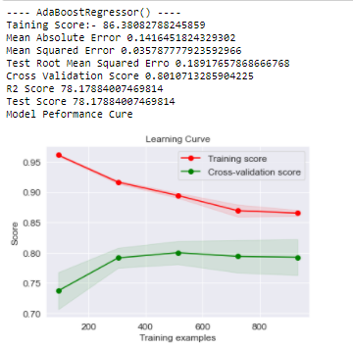
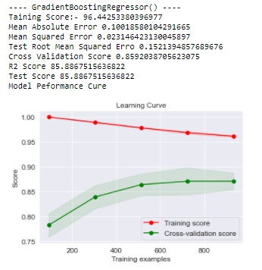
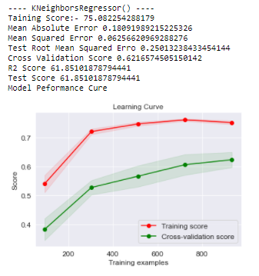
Performance Curve and Metrics Of Different Model

Slide 11
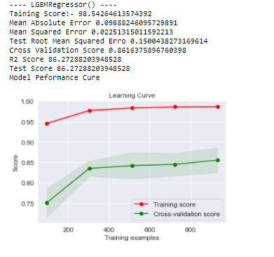
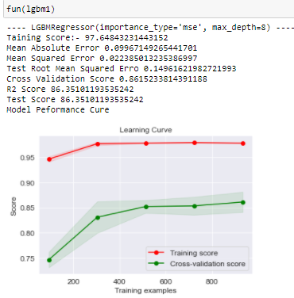
Finalized Model
Before Hyper Tunning
After Hyper Tunning
From RSME value and R2 and CV score we get the Best Result in the LGBM Regressor.

Slide 12
Conclusion: -
As this model is based on Australian Market only this model you can not apply globally.
From this model I learn many things and for this model Tree base algorithm is mostly use.
Here dataset is small so I used KFold Value 5 but if for big dataset KFold Value will be 10.
Here Data set having also many missing values and for future scope if I provide geological data like longitude and Latitude than I can visualize on Map so it will be more easy to under stand and having more impact.

Slide 13
Thank You

